Slide 1


Slide 2
Puppet VS Code Extension
James Pogran
Senior Software Engineer Puppet

Slide 3
Agenda
What is it?
Who wrote it?
What is in it?
Demo!

Slide 4
What is it?

Slide 5
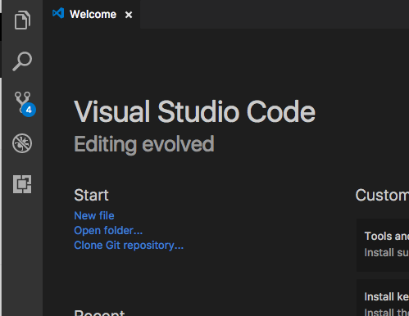
Visual Studio Code
One editor please
https://code.visualstudio.com
Light-weight streamlined code editor
Cross platform (Windows, Mac, Linux)
Extendable

Slide 6
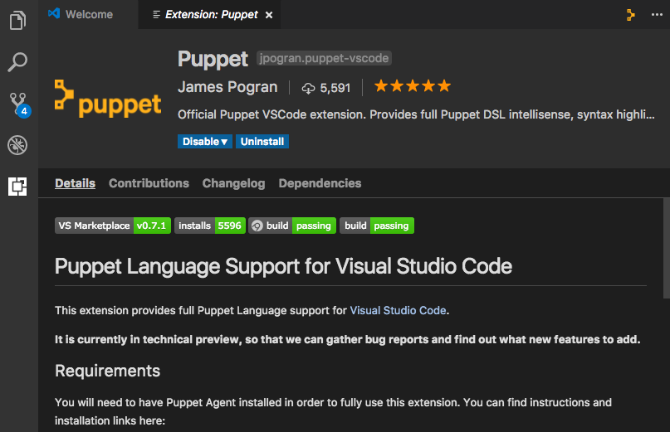
Puppet VS Code Extension
It’s alive!
VS Marketplace: puppet-vscode
Over 5,000 installs
0.7.1 latest version
Open source

Slide 7
Who wrote it?

Slide 8
Puppet VS Code Extension
Authors
James Pogran
Senior Software Engineer, Puppet
https://github.com/jpogran
@ender2025
http://jamespogran.com

Slide 9
Puppet VS Code Extension
Authors
Glenn Sarti
Senior Software Engineer, Puppet
https://github.com/glennsarti
@glennsarti
https://glennsarti.github.io

Slide 10
What is in it

Slide 11
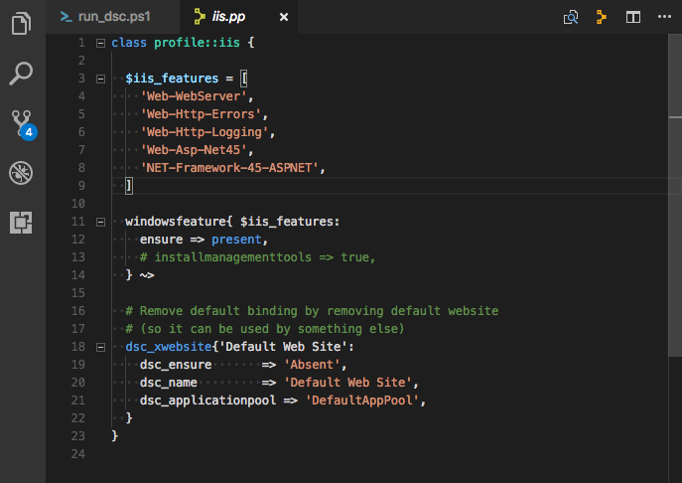
Puppet VS Code
Syntax highlighting

Slide 12
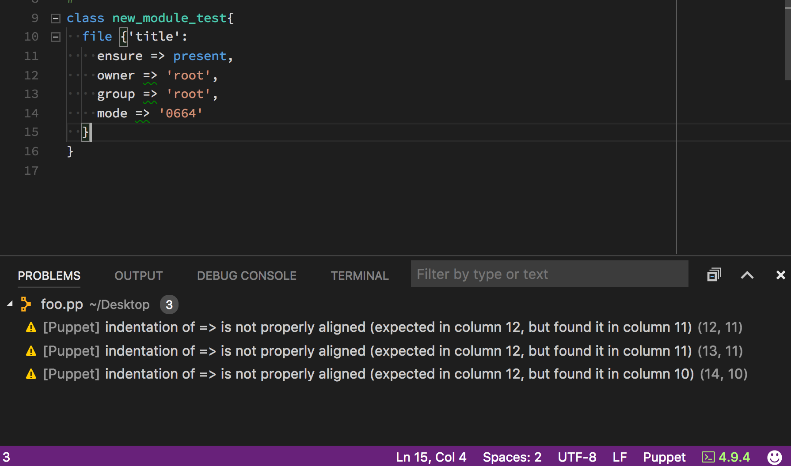
Puppet VS Code
Syntax validation

Slide 13
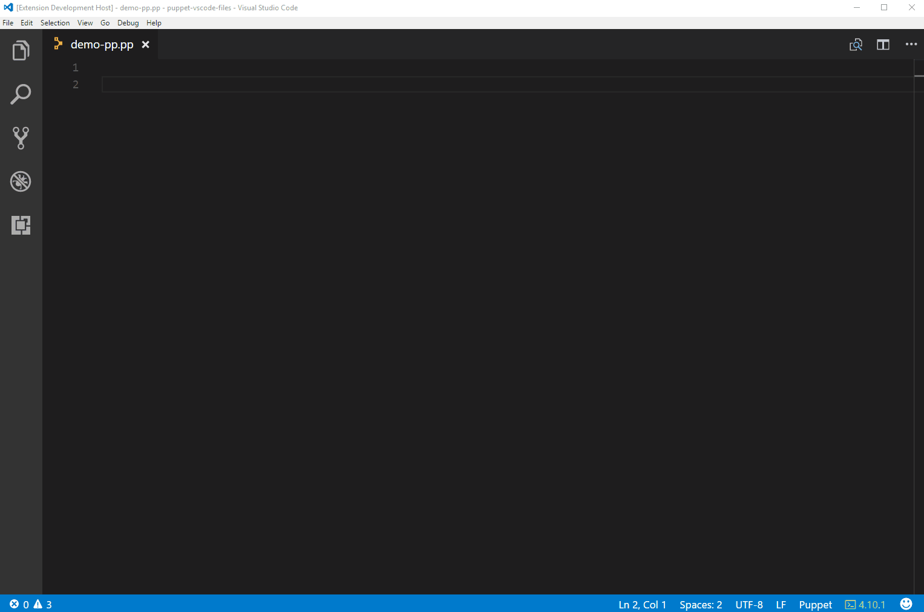
Puppet VS Code
Intellisense

Slide 14
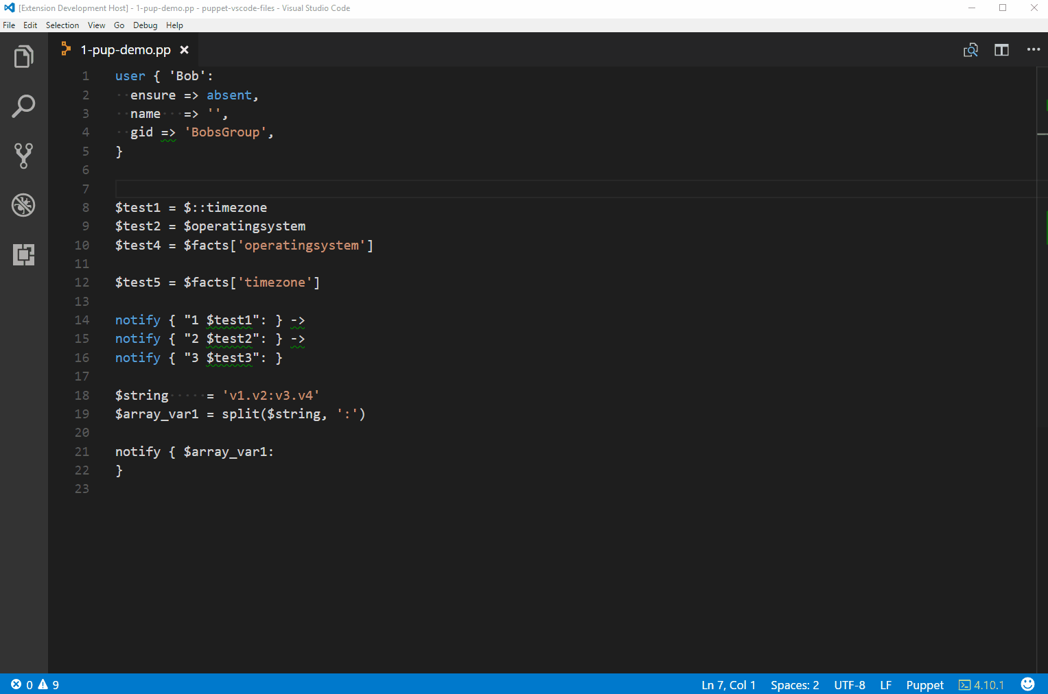
Puppet VS Code
Hover support

Slide 15
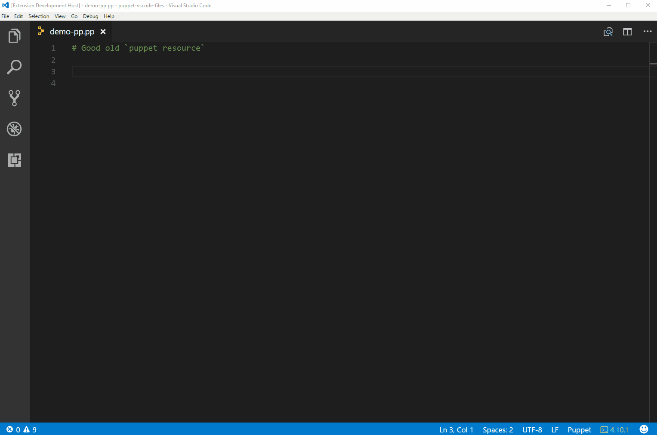
Puppet VS Code
Puppet Resource

Slide 16
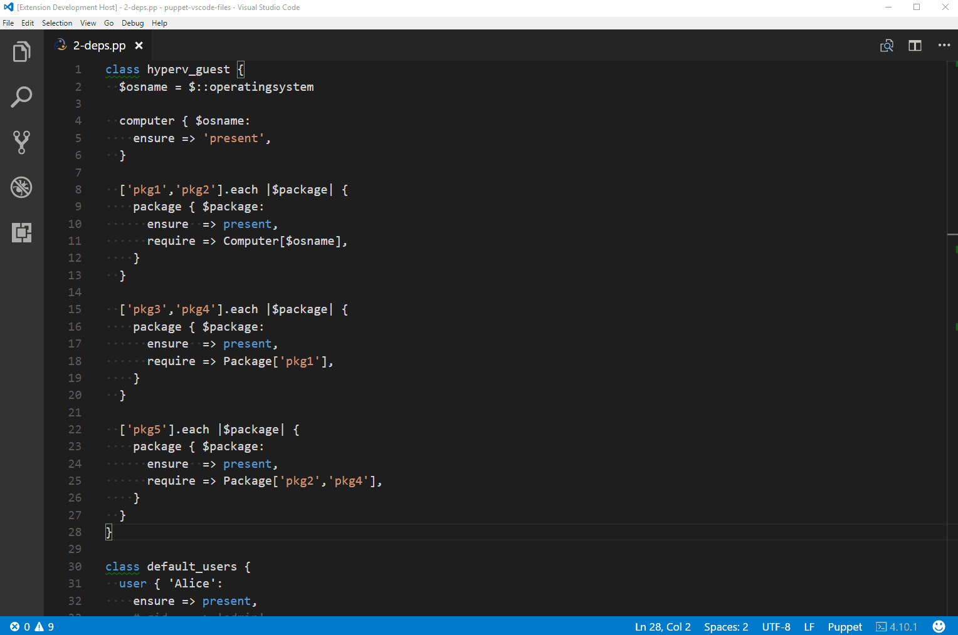
Puppet VS Code
Puppet Node Graph

Slide 17
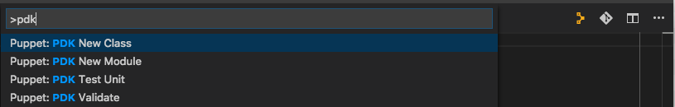
Puppet VS Code
Puppet Development Kit

Slide 18
Demo
But does it work?

Slide 19
Puppet VS Code Extension
We take Pull Requests!
We need your feedback!
https://github.com/jpogran/puppet-vscode/issues
https://github.com/jpogran/puppet-vscode/blob/master/client/CHANGELOG.md

Slide 20
Fin

